Slide 1



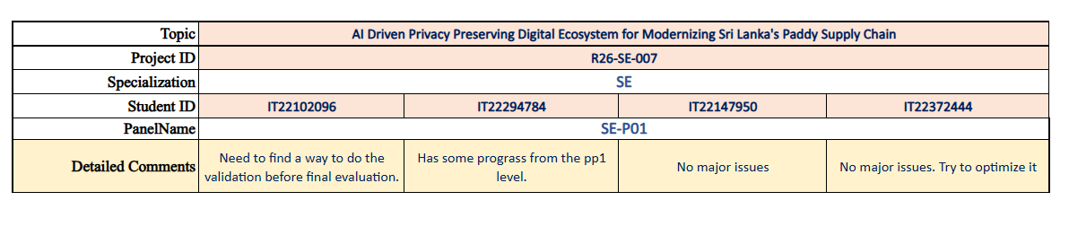
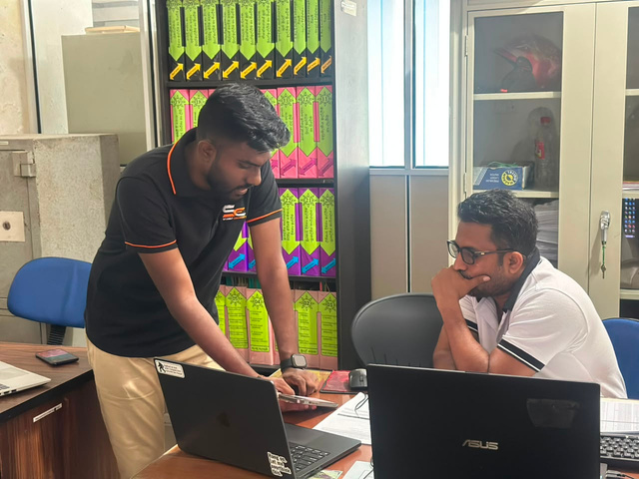
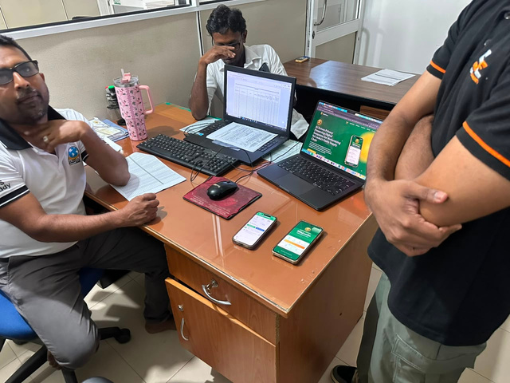
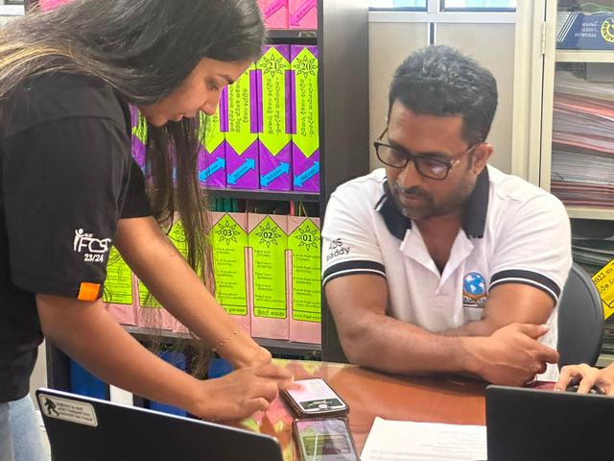
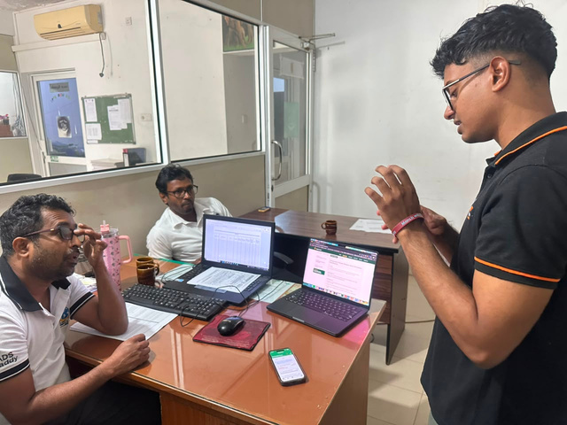
AI-Driven Privacy-Preserving Digital Ecosystem
Modernizing Sri Lanka's Paddy Supply Chain
Department of Software Engineering | Project ID: R26-SE-007
C1
C2
C3
C4
Paddy Price Prediction & Forecasting
Digital Dashboard for Paddy Farming
Farmer-Miller Digital Marketplace
Warehouse Coordination System
SLIIT | Faculty of Computing · Software Engineering Specialization · 2026

Slide 2



Project Supervision
SUPERVISOR
CO - SUPERVISOR
EXTERNAL SUPERVISOR
Mr. Suranga Senanayake
Regional Manager, Paddy Marketing Board
MABM (Univ. of Ruhuna),
B.Sc. Agric. Specializing in Food Science (Wayamba Univ.),
DHRM (Univ. of Colombo)
Dr. Mahima Weerasinghe
Senior Lecturer (Higher Grade)
Mr. Eishan Weerasinghe
Lecturer
SLIIT | Faculty of Computing · Software Engineering Specialization · 2026

Slide 3

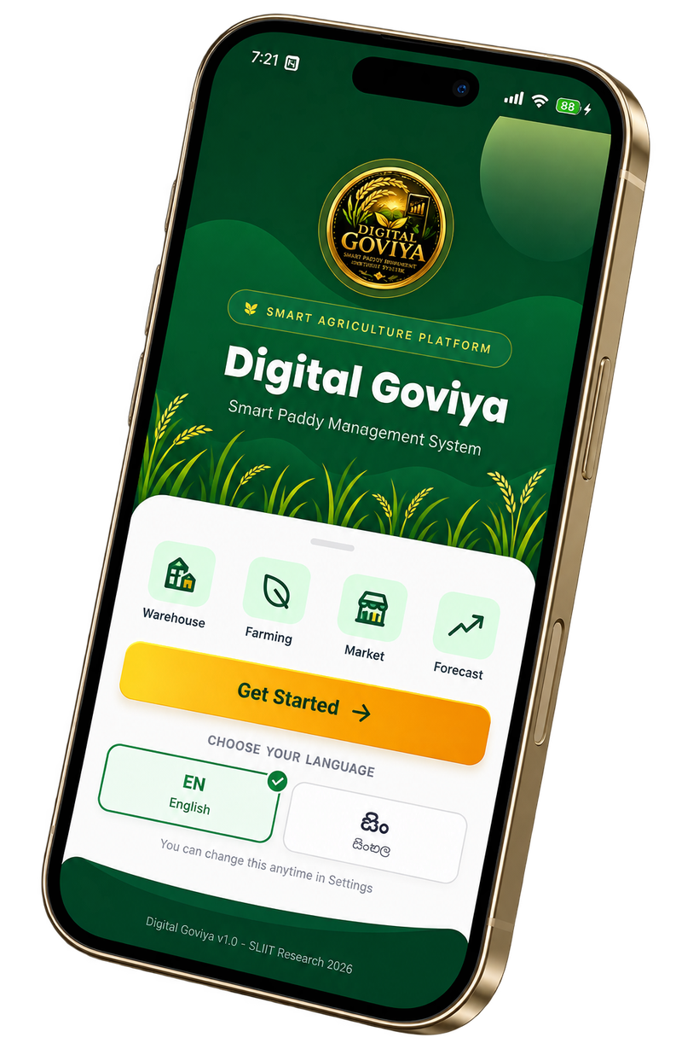
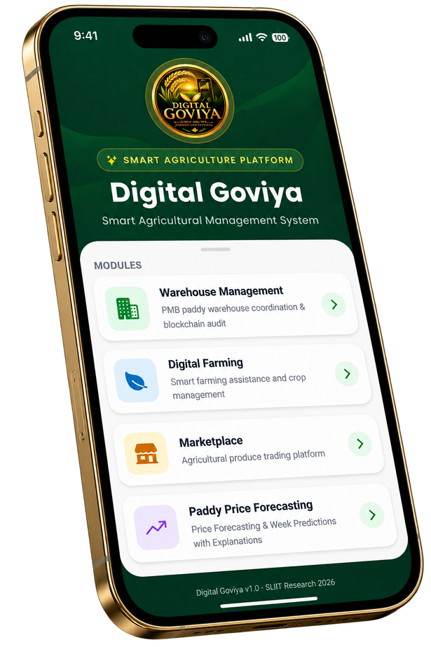
WE ARE ADDRESSING FOUR MAJOR PROBLEMS
COMPONENT 01
AI DRIVEN PADDY PRICE FORECASTING
COMPONENT 02
IOT INTEGRATED DIGITAL DASHBOARD FOR SMART PADDY FARMING
Farmers face unstable paddy prices, lack of reliable market information, and poor selling decisions, leading to financial losses.
Farmers lack real-time field monitoring, efficient resource management, early disease detection, and centralized farming insights, resulting in higher costs and reduced productivity.
COMPONENT 03
AI POWERED FARMER MILLER MARKETPLACE
Farmers face limited market access, unclear pricing, weak negotiation power, and low trust in digital marketplaces, reducing their income and market opportunities.
COMPONENT 04
BLOCKCHAIN BASED WAREHOUSE COORDINATION
Warehouses face manual coordination, insecure records, poor activity traceability, and limited audit transparency, causing delays and inefficient warehouse management.
SLIIT | Faculty of Computing · R26-SE-007 · 2026

Slide 4
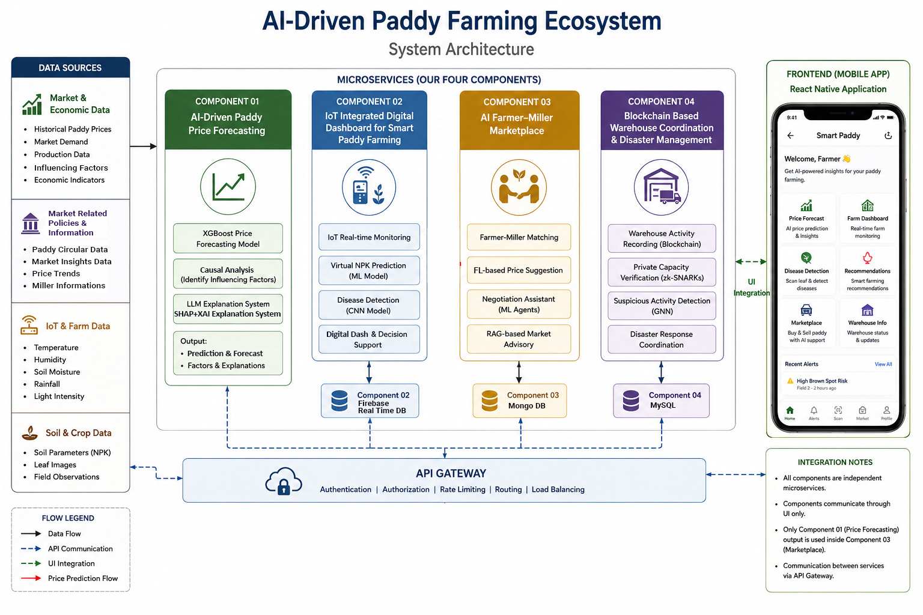
System Architecture: Integrated AI-Driven Ecosystem
[ System Diagram -- To Be Added ]
Insert your system architecture diagram here
SLIIT | Faculty of Computing · R26-SE-007 · 2026

Slide 5

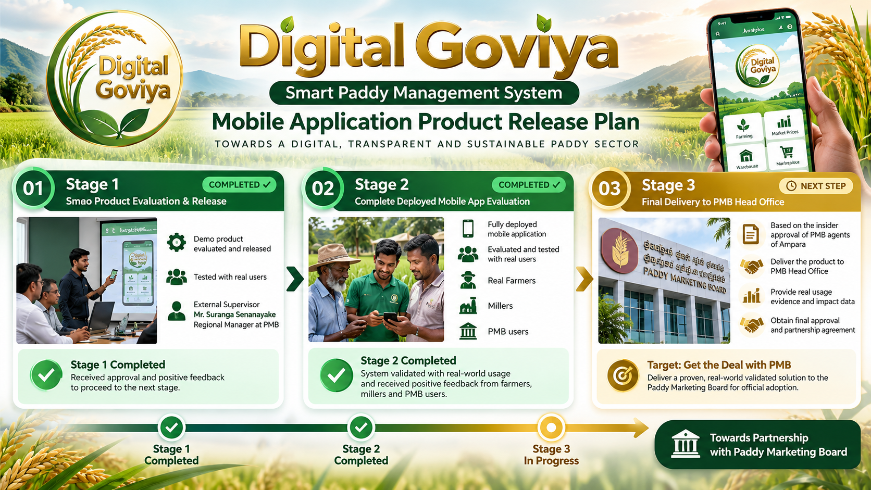
Digital Goviya: Product Release Plan
[ System Diagram -- To Be Added ]
Insert your system architecture diagram here
SLIIT | Faculty of Computing · R26-SE-007 · 2026

Slide 6
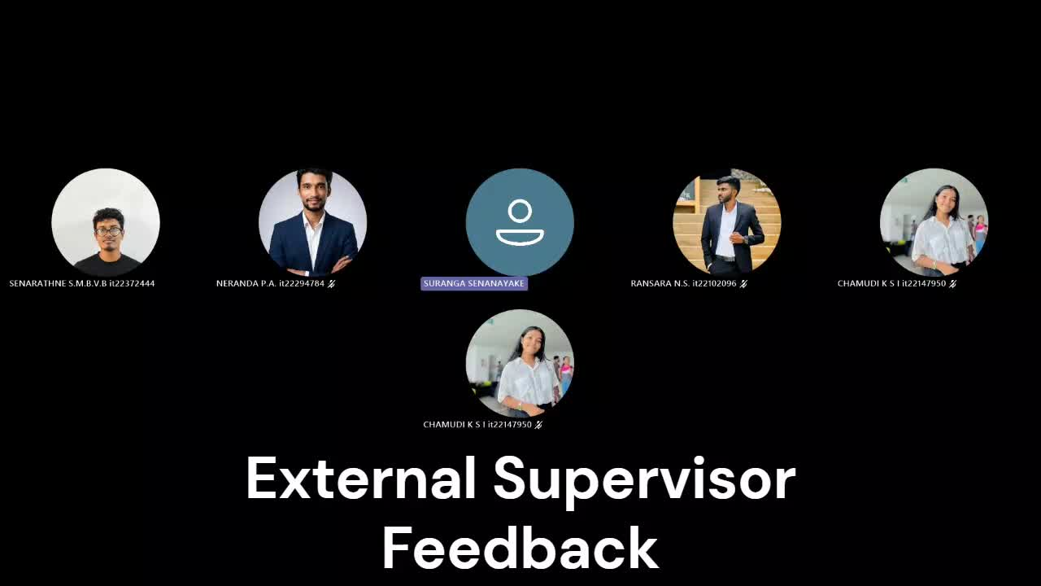
STAGE 1 - EXTERNAL SUPERVISOR EVALUATION FEEDBACK
SLIIT | Faculty of Computing

Slide 7

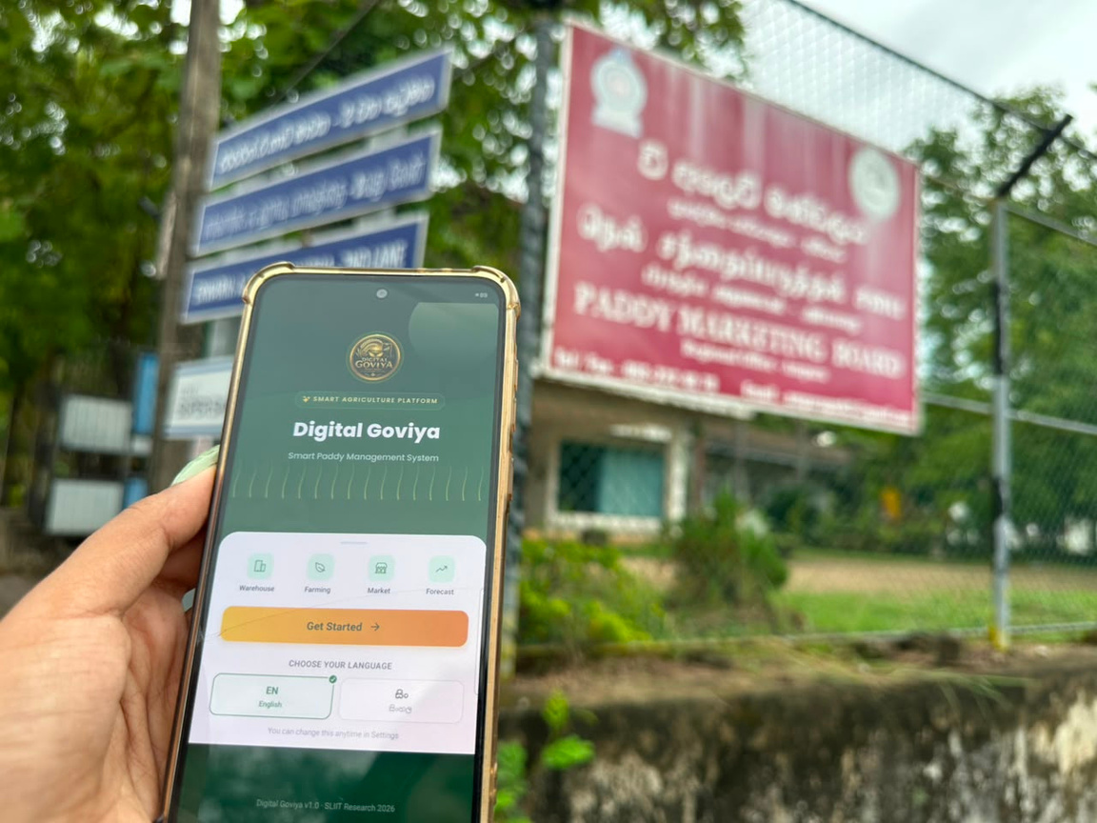

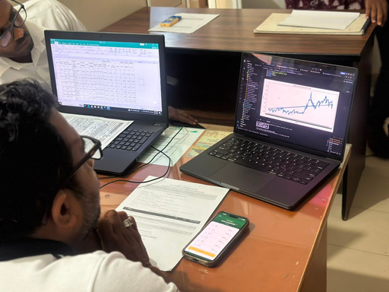
STAGE 2 - PRODUCT TEST WITH REAL USERS
PMB Agents, Farmers and Millers
PADDY MARKETING BOARD - AMPARA
SLIIT | Faculty of Computing

Slide 8

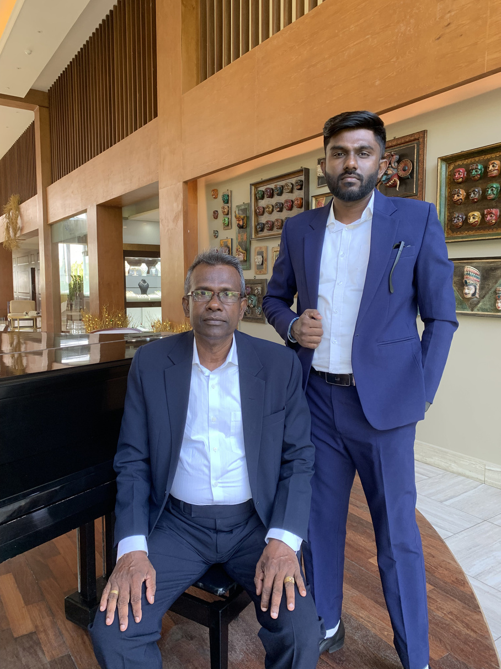
C1
C1 : IT22102096 | Ransara N.S.
Professional
Photo
AI-Driven Paddy Price Forecasting
XGBoost based forecasting with causal analysis, SHAP+LLM explanations
CONTRIBUTION TO OVERALL SOLUTION
Provides the market intelligence layer of the ecosystem. Forecasts future paddy prices by modeling production, seasonal, and policy factors, while generating human-readable explanations via a SHAP+LLM pipeline. Supports farmer planting decisions, miller procurement planning, and government policy analysis.
NOVELTY
First paddy price forecasting system to combine XGBoost prediction with explainability, AND integrate SHAP+XAI, LLM Explanation moving beyond "what will the price be?" to "why will it change?"
IT22102096 | Ransara N.S. | R26-SE-007

Slide 9
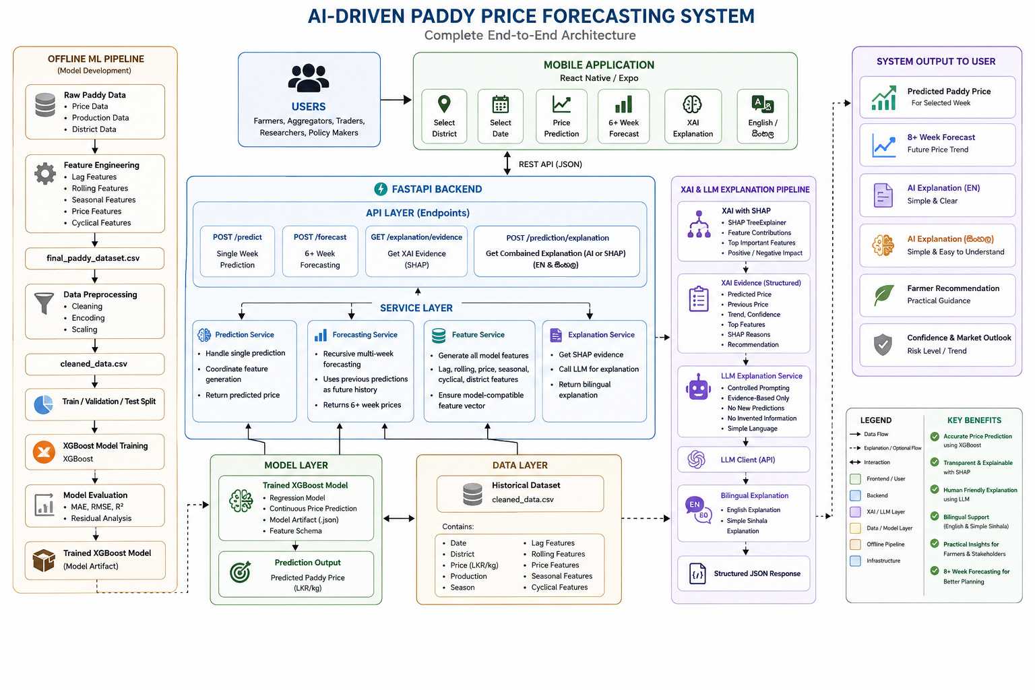
C1: AI-Driven Paddy Price Forecasting System Architecture
IT22102096 | Ransara N.S. | R26-SE-007

Slide 10
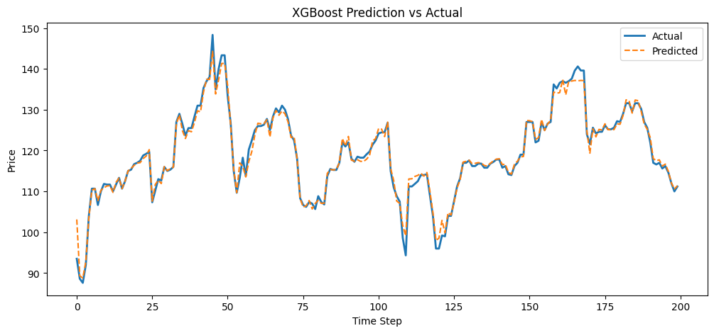
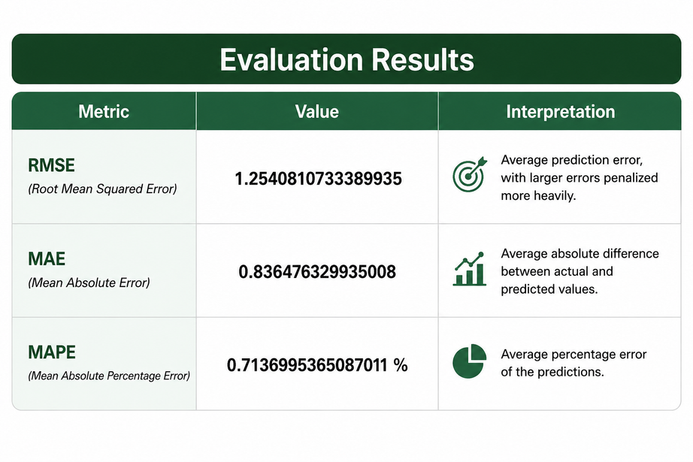
C1: Selected Model Evaluation Evidance
WHAT TYPE OF PROBLEM IS THIS?
paddy price forecasting/prediction, the target is a continuous numerical value that’s why
this is a regression problem
EVALUATION METRICS
The graph indicates that the XGBoost regression model provides good prediction performance with relatively small errors.
IT22102096 | Ransara N.S. | R26-SE-007

Slide 11
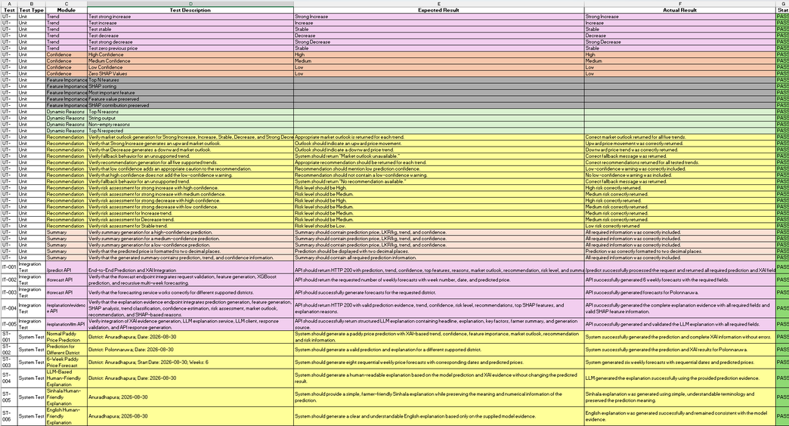
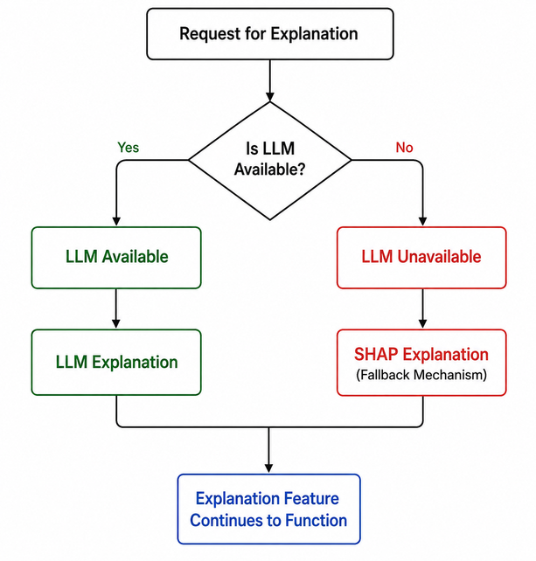
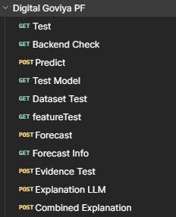
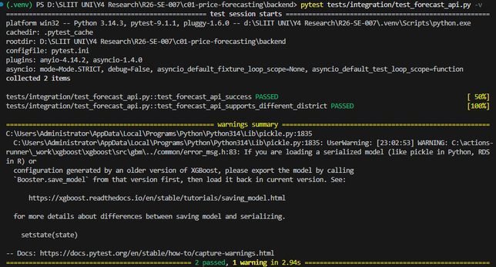
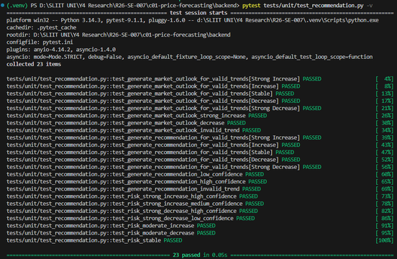
C1: Testing Evidence
Unit Tests, Integration Tests
System Tests, NFR Measurements
Details QA Report
Availability/ Fault Tolarance
System Testing via POSTMAN
Integration Tests
Unit Tests
IT22102096 | Ransara N.S. | R26-SE-007

Slide 12

C2
C2 : IT22294784 | Kumarasinghe P.A.N.D.
Professional
Photo
IoT Integrated Digital Dashboard for Paddy Farming
IoT-integrated Farmer Advisory System with yield prediction, disease detection and Fertilizer Recommendation system
CONTRIBUTION TO OVERALL SOLUTION
Provides the real-time field intelligence layer of the ecosystem. IoT sensor data feeds a dynamic digital model, enabling predictive yield estimation, disease detection and fertilizer recommendations — giving farmers actionable guidance throughout both Maha and Yala cultivation seasons.
NOVELTY
In this System combine both live IoT-driven digital dashboard with image-based multi-stage paddy disease detection, delivering treatment recommendations — no existing solution integrates both layers simultaneously - All in on Farmer specific Guidence System
IT22294784 | Kumarasinghe P.A.N.D.| R26-SE-007

Slide 13
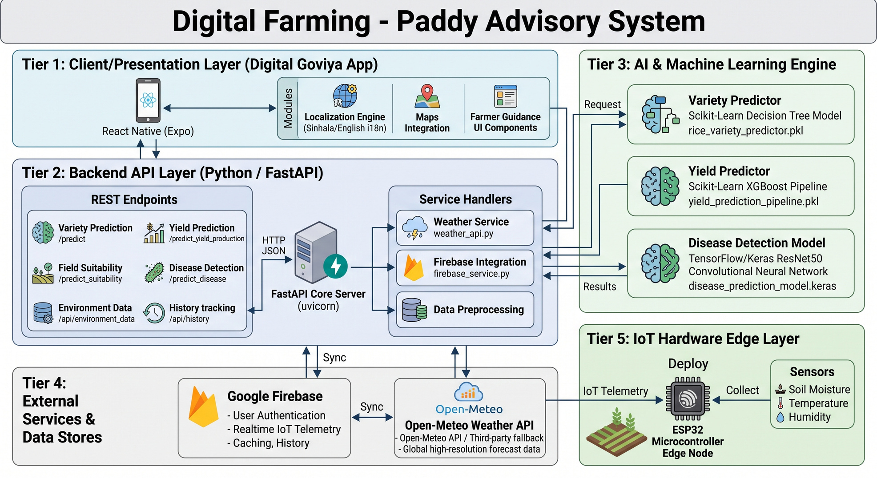
C2: IoT Integrated Digital Dashboard for Smart Paddy Farming
IT22294784 | Neranda Dilhara | R26-SE-007

Slide 14
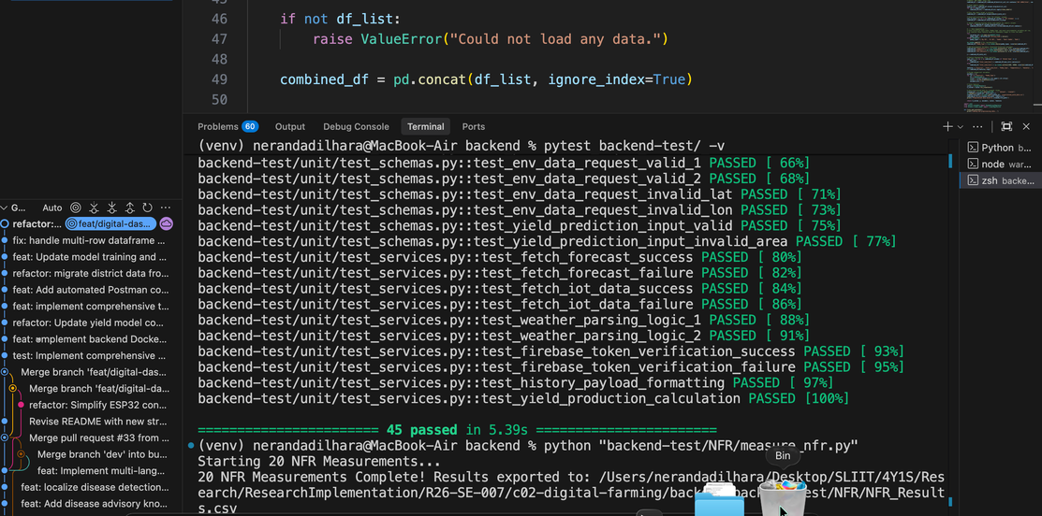
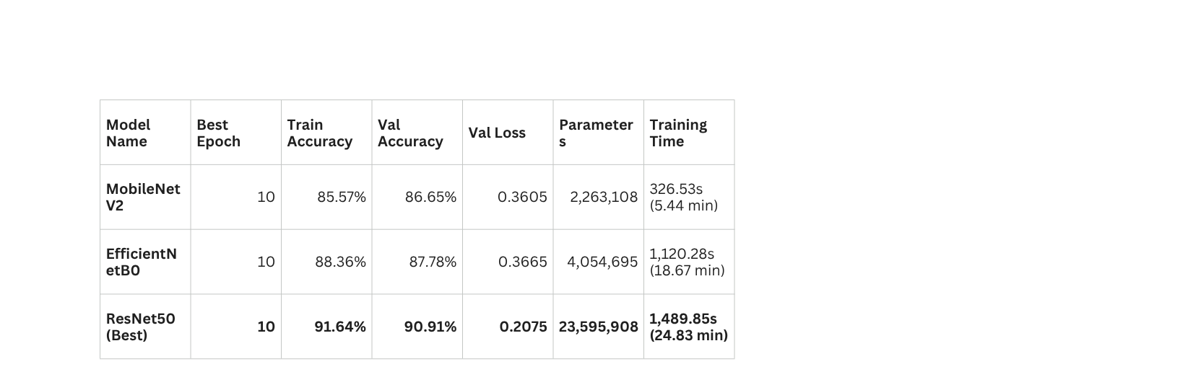
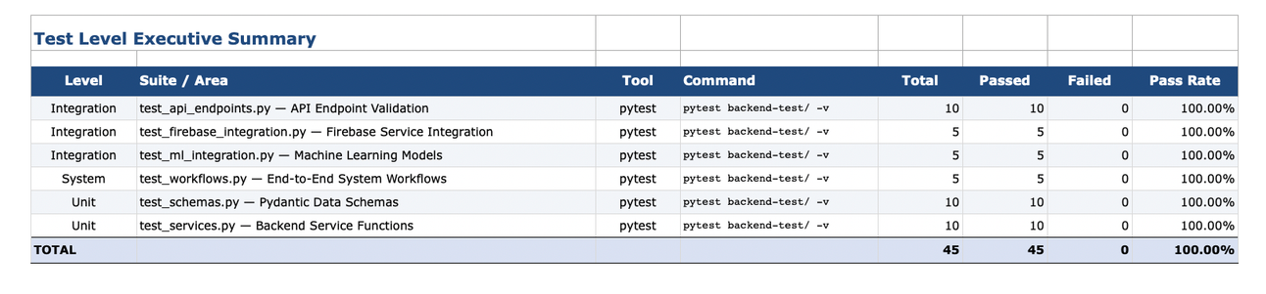
C2: Selected Model Evaluation Evidance
WHAT TYPE OF PROBLEM IS THIS?
IoT Integrated Digital Dashboard with Farmer Guidance System
Rice Variety Prediction (Target - Variety)
Paddy Leaf Disease Detection
Paddy Yield Prediction (Target - Yield Amount)
Fertilizer Reccomendation
EVELUATION METRICS
TESTING
IT22294784 | Neranda Dilhara | R26-SE-007

Slide 15

C3
C3 : IT22147950 | Chamudi K.S.I.
Professional
Photo
AI-Powered Farmer–Miller Marketplace
Multi-agent AI negotiation and RAG trading assistant with Privacy-preserving federated marketplace
CONTRIBUTION TO OVERALL SOLUTION
Provides the market access layer that directly empowers farmers and millers. Farmers receive personalized AI guidance; millers gain predictable supply; and an automated negotiation module helps both parties reach equitable agreements.
NOVELTY
RAG Assistant for personalized market advice, Federated Learning Engine for privacy-preserving learning, Secure Matching Engine for anonymous farmer–miller matching, and a Multi-Agent Negotiation Engine for fair price discovery. These four capabilities are rarely integrated together in existing agricultural marketplaces.
IT22147950 | Chamudi K.S.I| R26-SE-007

Slide 16
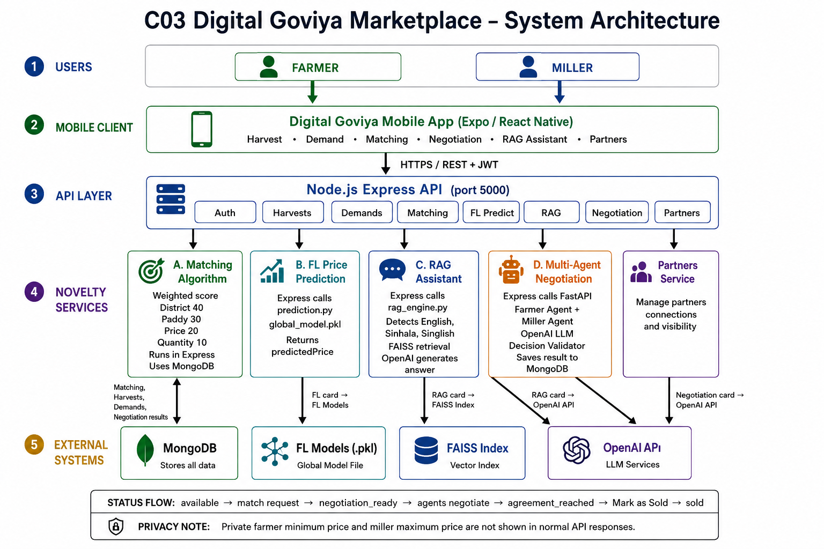
C3: AI Powered Farmer Miller Marketplace
System Diagram
IT22147950 | Chamudi K.S.I. | R26-SE-007

Slide 17
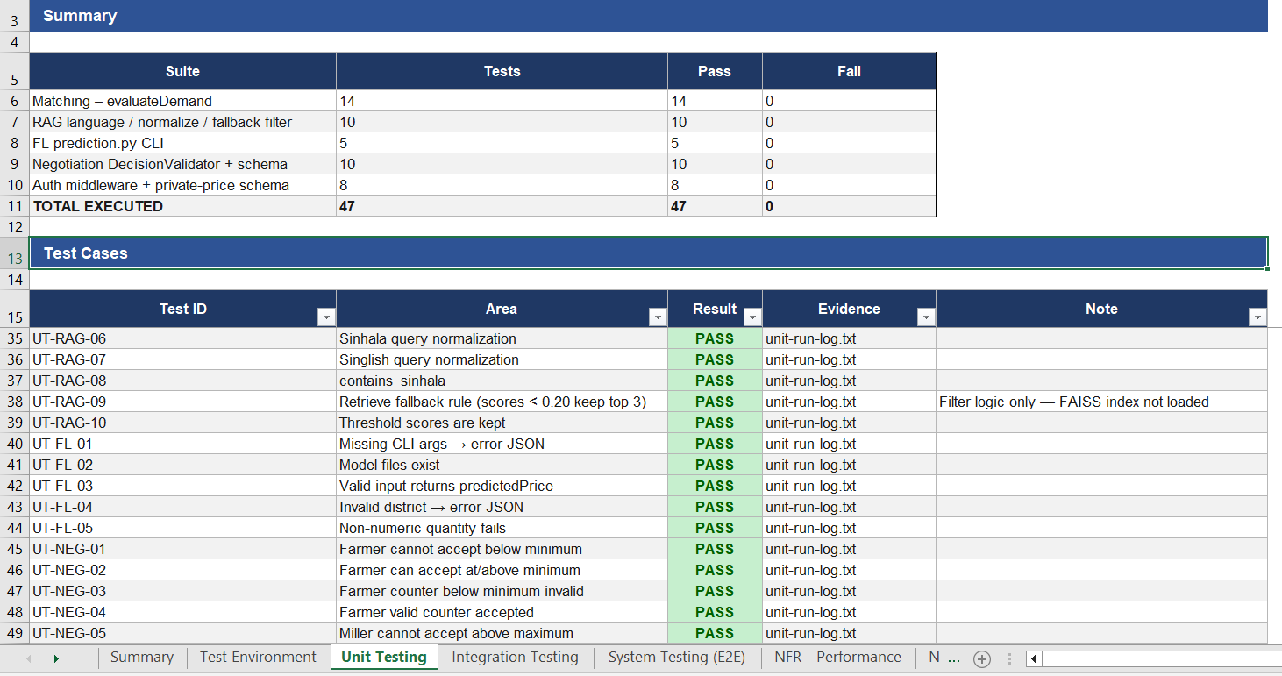
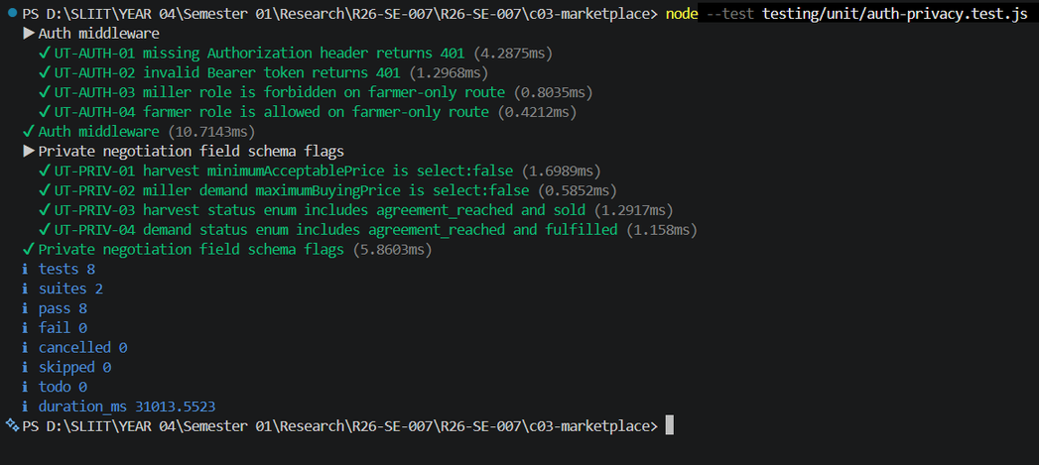
C3 : Testing Evidence
IT22147950 | Chamudi K.S.I. | R26-SE-007

Slide 18

C4
C4 : IT22372444 | Senarathne S.M.B.V.B.
Professional
Photo
Blockchain-Based Warehouse Coordination
Cryptographic stock verification and privacy-preserving redistribution for PMB Regional Managers
CONTRIBUTION TO OVERALL SOLUTION
Provides the storage and logistics intelligence layer. Replaces informal WhatsApp/phone-based warehouse coordination with a blockchain-backed system that cryptographically verifies stock levels, creates immutable audit trails for all redistribution decisions, and enables privacy-preserving data sharing across PMB districts during normal operations and emergencies.
NOVELTY
First system applying blockchain-based cryptographic accountability specifically to public agricultural warehouse networks. Uniquely addresses disaster response coordination (floods, elephant attacks) with verifiable capacity queries and privacy-preserving inter-district data sharing a gap unaddressed by any existing agricultural logistics platform.
IT22372444 | Senarathne S.M.B.V.B.| R26-SE-007

Slide 19
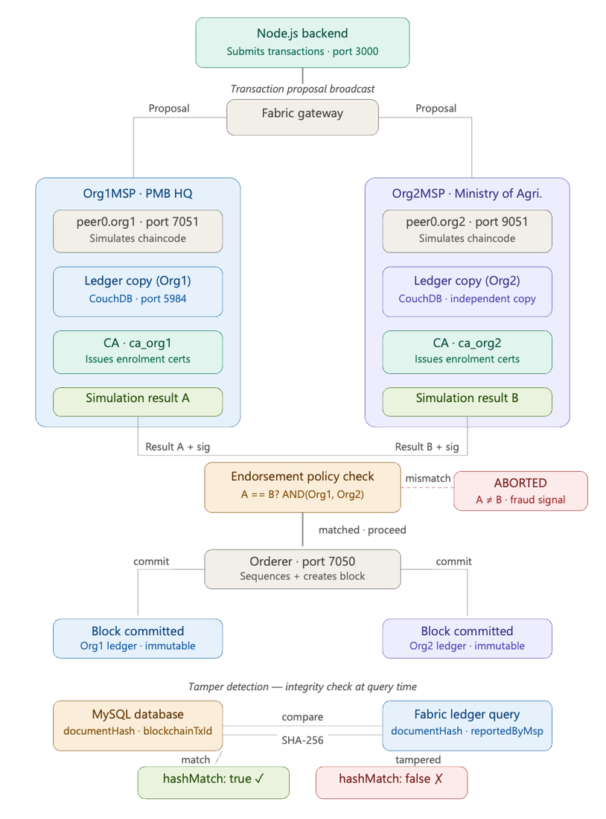
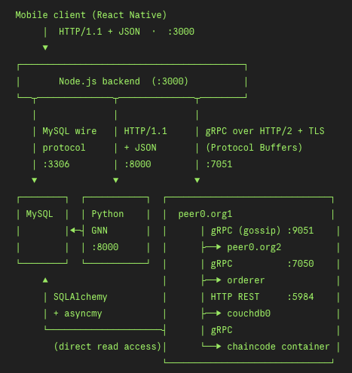
C4: Blockchain Based Warehouse Coordination
IT22294784 | Neranda Dilhara | R26-SE-007

Slide 20
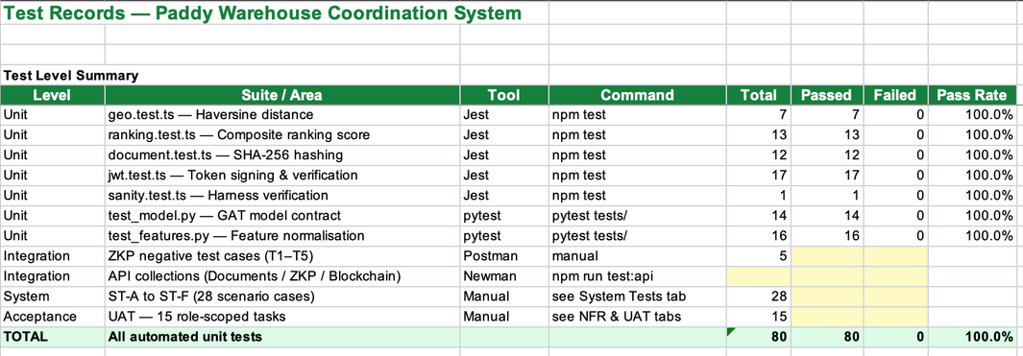
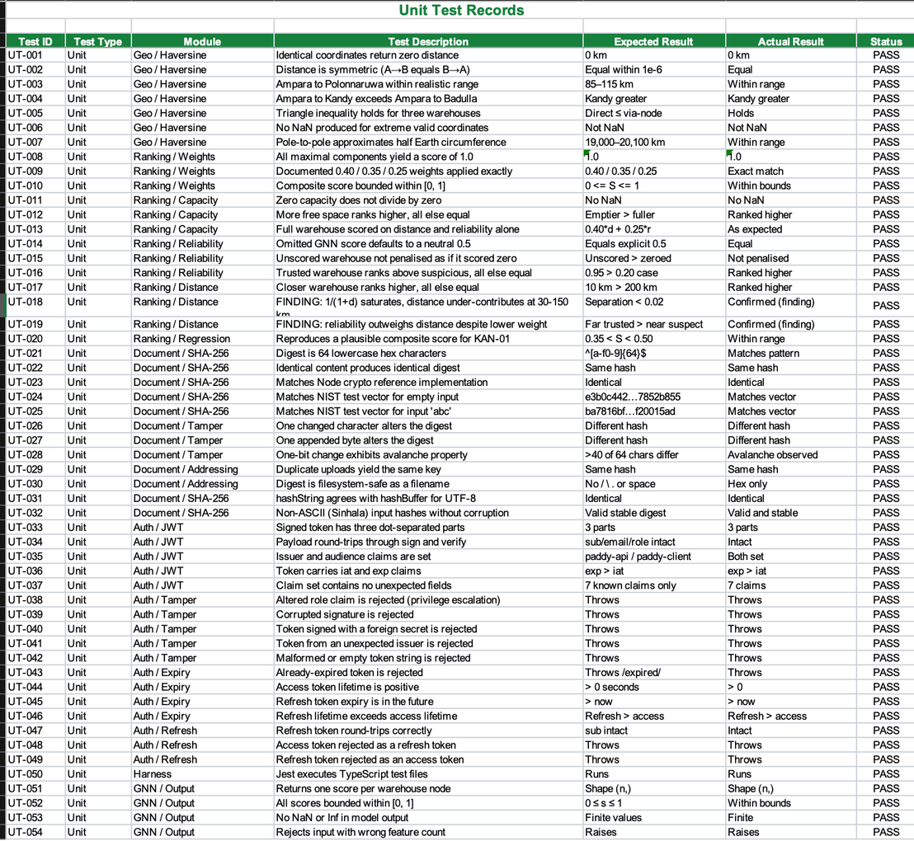
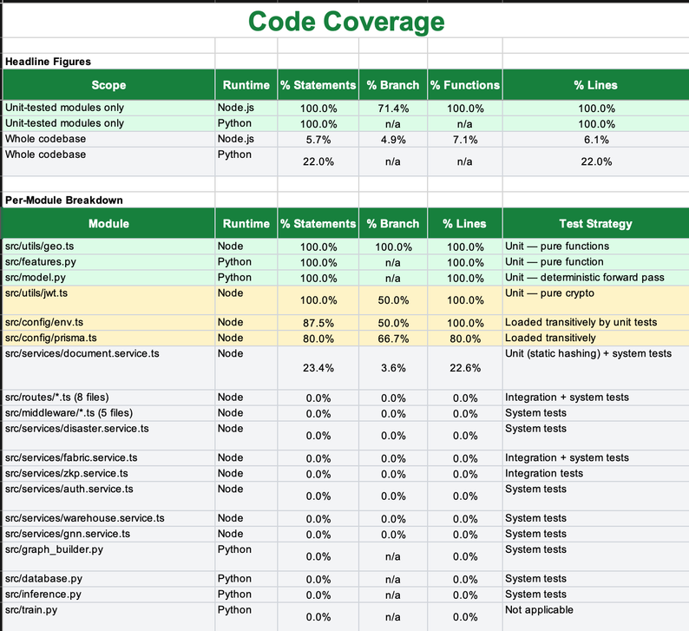
Testing Evidence
IT22372444 | Senarathne S.M.B.V.B. | R26-SE-007

Slide 21

Thank You
We welcome your questions and feedback.
AI-Driven Privacy-Preserving Digital Ecosystem for Sri Lanka’s Paddy Supply Chain
Project ID: R26-SE-007 | SLIIT Faculty of Computing | Software Engineering Specialization | 2026
SLIIT | Faculty of Computing · Software Engineering Specialization · 2026

